Slide 1
The PIC microcontroller
PIC18F4520: CCP and ECCP

Slide 2
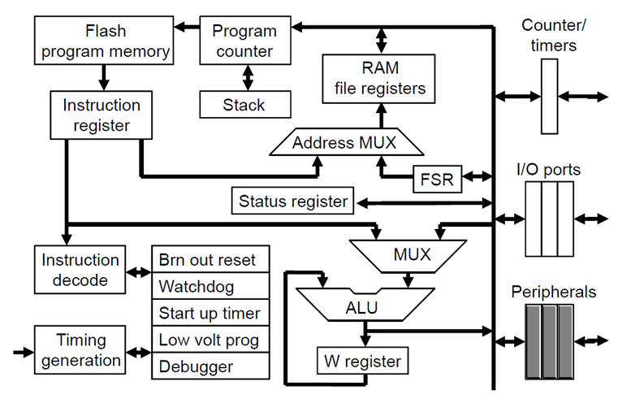
PIC18F: Controller Architecture

Slide 3
PIC18F: Notational convention
WREG
W Register
FREG
File Register (any register location from GPR Bank 0 / SFR)
[X]
Contents of register X
[WREG] = 0x02 ↔ WREG’s contents become 0x02
[0x20] = 0x34 ↔ RAM File Register 0x20 content becomes 0x34
[X] = [Y] ↔ Contents of Y are copied into X
Number systems
Decimal | d’10’
Hexadecimal | h’4A’ or 0x4A
Binary | b’1000 0010’

Slide 4
CCP concept

Slide 5
PIC18F: CCP Module
PIC has a unique hardware module called CCP
Tri-function module
Compare
Capture
PWM
Used for control of hardware interfaces / devices
Compare
Complex automated if-then output signal to hardware
Capture
Free-running edge-detection, time snapshotting
PWM
Precise (2 decimal places!) CPU-independent PWMs
PIC18F4520 has 2 CCP modules
CCP1, CCP2
In addition
CCP1 can work as an ECCP (Enhanced CCP) module

Slide 6
PIC18F: What is CCP?
Compare
Compare a TIMER register to a pre-loaded CCPR register
On value match, control a CCP pin (output) – rise, fall, toggle, etc.
Capture
With a TIMER running, ingest a signal at a CCP pin (input)
Capture value of TIMER register into CCPR register on an interesting event in the signal – rising edge / falling edge
PWM
Using a TIMER, generate a precise PWM wave at CCP pin (output)
Frequency and Duty Cycle controlled by CCPR register

Slide 7
CCP1 on PIC18F4520

Slide 8
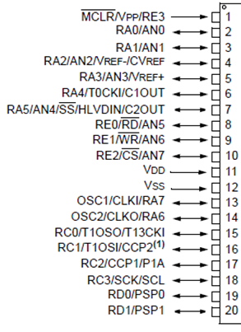
PIC18F: CCP1 Details
CCP1 module resources
Registers:
Configuration, control: CCP1CON
Timer selection: T3CON
CCPR register: CCPR1H:CCPR1L (16-bit)
PWM: PR2 (8-bit)
Timer(s):
Compare/Capture mode: Timer1 / Timer3
PWM mode: Timer2
Hardware pin(s):
CCP1 / RC2
T13CKI (clock input for chosen timer)

Slide 9
PIC18F: CCP1CON
-
-
DC1B1
DC1B2
CCP1M3
CCP1M2
CCP1M1
CCP1M0
CCP1M<3:0>: CCP1 mode select bits
0000 CCP1 is off / disabled
0001 Reserved
0010 Compare mode – Toggle CCP1 on match
0011 Reserved
0100 Capture mode – every falling edge
0101 Capture mode – every rising edge
0110 Capture mode – every 4th rising edge
0111 Capture mode – every 16th rising edge
1000 Compare mode – CCP1 init low, match high, CCP1IF set
1001 Compare mode – CCP1 init high, match low, CCP1IF set
1010 Compare mode – Generate s/w interrupt, CCP1 no effect
1011 Compare mode – Special event, CCP1IF set, timer cleared
11xx PWM mode
DC1B<1,2>: Duty cycle fractional part control bits for PWM
Used only in PWM mode

Slide 10
PIC18F: CCP1 – Timer selection
CCP1 choice of Timers
Compare / Capture modes – Timer1 / Timer3
PWM – Timer2 only
Compare / Capture Timer chosen by bits in T3CON
T3CCP<2:1>: Timer selection bits for CCP modules
00 Use Timer1 for both CCP modules
01 Use Timer1 for CCP1, and Timer3 for CCP2
1x Use Timer3 for both CCP modules
Chosen Timer controlled by corresponding TxCON
RD16
T3CCP2
T3CKPS1
T2CKPS2
T3CCP1
T3SYNC
TMR3CS
TMR3ON

Slide 11
CCP1 compare mode

Slide 12
PIC18F: CCP1 – Compare mode
Control
T1CON
CCP1 interrupt
CCP1IF
TMR1H
TMR1L
Reset TIMER
Ticking!
Set IF
Match
CCP1
Logic
Compare
Effect
CCP1M3
CCPR1H
CCPR1L
CCP1M2
Pre-loaded
CCP1M1
CCP1/RC2 pin
CCP1M0

Slide 13
PIC18F: CCP1 – Compare details
Control the behaviour of the CCP1 pin (output)
When there is a “Compare Match”
When [CCPR1H:CCPR1L] == [TMR1H:TMR1L]
This happens once in the cycle of TMR1 when it ‘ticks’
In its journey from 0x0000 to 0xFFFF
Behaviour controls
Drive CCP1 from low to high – positive edge/pulse
Drive CCP1 from high to low – negative edge/pulse
Toggle CCP1
Generate a software interrupt, and set CCP1IF
Trigger a special event in hardware, and reset the timer

Slide 14
PIC18F: CCP1 – Compare usage
Configure
Initialize CCP1CON for proper compare mode
Select Timer by writing to T3CON
Configure chosen Timer (by writing T1CON / T3CON)
Make CCP1/RC2 output (say, BCF TRISC, 2)
Load
Load CCPR registers (CCPR1H:CCPR1L)
Load Timer registers (TMR1H:TMR1L or TMR3H:TMR3L)
Reset CCP1IF
Start
Start Timer (TMR1 / TMR3)
Monitor / Service
CCP1IF flag / CCP1 interrupt

Slide 15
PIC18F: CCP1 – Compare code
Make CCP1 toggle on compare match for CCPR1 value of 0x1234
MOVLW 0x02
MOVWF CCP1CON ; compare mode, toggle on match
CLRF T3CON ; choose TIMER1
CLRF T1CON ; 16-bit, Internal CLK, 1:1 prescale, etc.
BCF TRISC, 2 ; make CCP1 / RC2 output
MOVLW 0x12
MOVWF CCPR1H
MOVLW 0x34
MOVWF CCPR1L ; load CCPR1 with value
L1 CLRF TMR1H
CLRF TMR1L
BCF PIR1, CCP1IF ; reset CCP1IF
BSF T1CON, TMR1ON ; start TIMER1
L2 BTFSS PIR1, CCP1IF ; monitor CCP1IF
BRA L2
BCF T1CON, TMR1ON ; stop TIMER1
BRA L1
TMR1H:L
0x0000
…
…
0x1234
…
...
0xFFFF
toggle

Slide 16
Ccp1 capture mode

Slide 17
PIC18F: CCP1 – Capture mode
CCP1IF
T1CON
Set IF
Control
External Signal
Edge detect
Counting!
TMR1H
TMR1L
CCP1/RC2 pin
CCP1
Logic
Edge*
Capture
Value
CCPR1H
CCPR1L
Capture
CCP1M3
CCP1M2
CCP1M1
CCP1M0
* Rising, falling, 4th rising, 16th rising

Slide 18
PIC18F: CCP1 – Capture details
Ingest a signal at CCP1/RC2 pin (input)
Start a TIMER
While this TIMER is running (‘ticking’)
Detect pattern of interest
On detection
Capture the value of its TIMER register (TMRxH:TMRxL)
Into CCPR1H:CCPR1L
Choices for pattern of interest
Rising edge
Falling edge
Every 4th rising edge
Every 16th rising edge
Snapshot when pattern occurred

Slide 19
PIC18F: CCP1 – Capture usage
Configure
Initialize CCP1CON for proper capture mode
Select Timer by writing to T3CON
Configure chosen Timer (by writing T1CON / T3CON)
Make CCP1/RC2 input (say, BSF TRISC, 2)
Reset CCP1IF
Reset Timer registers (TMR1H:TMR1L or TMR3H:TMR3L)
Wait-1
Wait for pattern of interest to occur at CCP1 (monitor CCP1IF)
Load & Start
Start Timer (TMR1 / TMR3)
Wait-2
Wait for pattern of interest to occur at CCP1 (monitor CCP1IF)
Read values
Stop Timer (TMR1 / TMR3)
Read the captured value of CCPR1H:CCPR1L
Timer start
Timer stop
T
T = n * T_{TMR}

Slide 20
PCI18F: CCP1 – Capture code
Measure the period of input pulse applied at CCP1/RC2
MOVLW 0x05
MOVWF CCP1CON ; capture mode, rising edge
CLRF T3CON ; choose TIMER1
CLRF T1CON ; 16-bit, Internal CLK, 1:1 prescale, etc.
BSF TRISC, 2 ; make CCP1/RC2 input
CLRF TMR1H
CLRF TMR1L
BCF PIR1, CCP1IF ; clear IF
RISE1 BTFSS PIR1, CCP1IF ; wait for 1st rising edge
BRA RISE1
BCF PIR1, CCP1IF ; 1st edge detected, clear IF
BSF T1CON, TMR1ON ; start TIMER1
RISE2 BTFSS PIR1, CCP1IF ; wait for 2nd rising edge
BRA RISE2
BCF T1CON, TMR1ON ; 2nd edge detected, stop TIMER1
GOTO $
CCPR1H:CCPR1L contain ticks counted by TIMER1

Slide 21
Ccp1 pwm mode

Slide 22
PIC18F: CCP1 – PWM mode
Timer ON
Control
T2CON
TMR2H
TMR2L
Load TIMER
Ticking!
CCP1
Logic
PWM
CCP1M3
PR2
CCPR1L
CCP1M2
CCP1M1
CCP1/RC2 pin
DC1B1
DC1B2
CCP1M0
Loaded with values

Slide 23
PIC18F: CCP1 – PWM details
Hardware controlled generation of PWM
Waveform appears at CCP1/RC2 pin (output)
Uses TIMER2
Precise control of frequency and Duty Cycle (DC)
DC control up to 2 decimal places!
PWM control registers
Frequency control
PR2 (8-bit) register – is in SFR
Pre-scale ratio of TIMER2
DC control
CCPR1L (integer part), DC1B1, DC1B2 (fractional part)

Slide 24
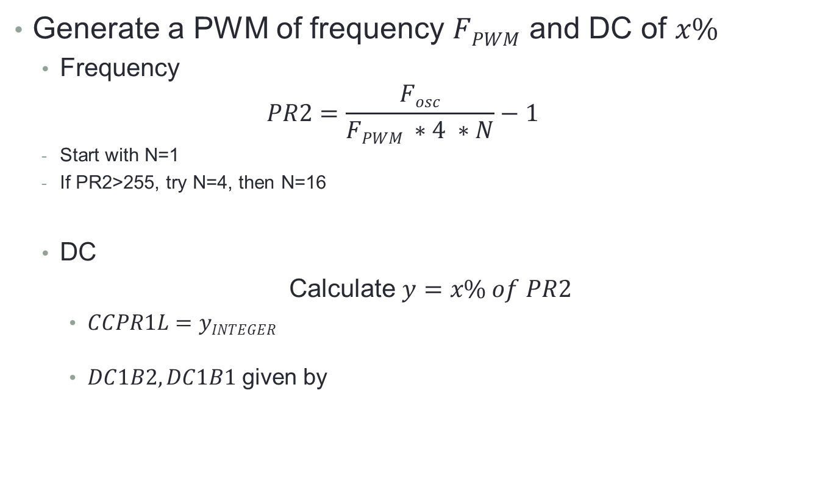
PIC18F: CCP1 – PWM equations
Generate a PWM of frequency $FPWM$ and DC of $x\%$
Frequency
$$PR2=\frac{Fosc}{FPWM ∗4 ∗N}−1$$
Start with N=1
If PR2>255, try N=4, then N=16
DC
Calculate $y=x\% of PR2$
$CCPR1L=yINTEGER$
$DC1B2, DC1B1$ given by
y_{FRACTION} | DC1B2 | DC1B1
0 | 0 | 0
0.25 | 0 | 1
0.50 | 1 | 0
0.75 | 1 | 1

Slide 25
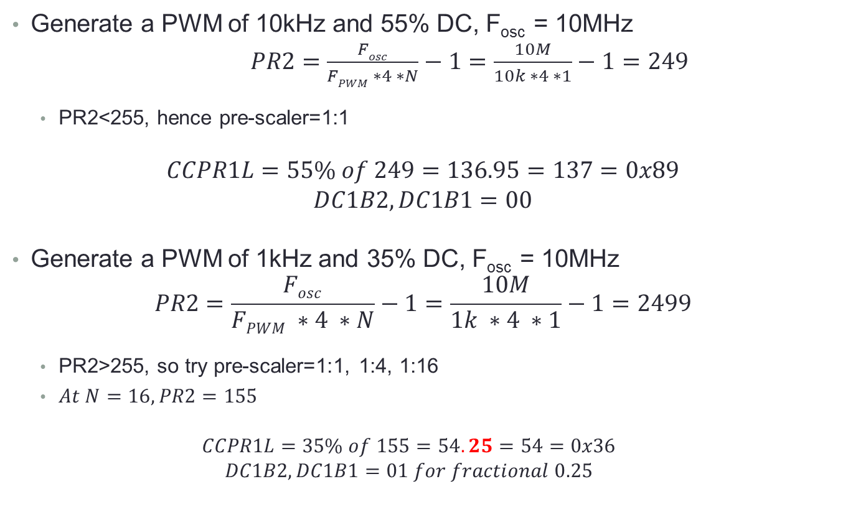
PIC18F: CCP1 – PWM scenarios
Generate a PWM of 10kHz and 55% DC, F_{osc} = 10MHz
$PR2=\frac{Fosc}{FPWM ∗4 ∗N}−1=\frac{10M}{10k ∗4 ∗1}−1=249$
PR2<255, hence pre-scaler=1:1
$$CCPR1L=55\% of 249=136.95=137=0x89$$
$$DC1B2, DC1B1=00$$
Generate a PWM of 1kHz and 35% DC, F_{osc} = 10MHz
$$PR2=\frac{Fosc}{FPWM ∗4 ∗N}−1=\frac{10M}{1k ∗4 ∗1}−1=2499$$
PR2>255, so try pre-scaler=1:1, 1:4, 1:16
$At N=16, PR2=155$
$$CCPR1L=35\% of 155=54.25=54=0x36$$
$$DC1B2, DC1B1=01 for fractional 0.25$$

Slide 26
PIC18F: CCP1 – PWM usage
Pre-calculate
PR2, pre-scaler for TIMER2, CCPR1L, DC1B2:DC1B1
Configure CCP1CON for PWM mode
Load DC bits as well
Load PR2
Configure T2CON
Load CCPR1L
Make CCP1/RC2 an output pin
Clear TMR2H:TMR2L
Start TIMER2

Slide 27
PIC8F: CCP1 – PWM code
Generate a PWM of 1kHz and DC 35% at CCP1
MOVLW 0x1C
MOVWF CCP1CON ; PWM mode, 0.25% DC bits
MOVLW d’155’
MOVWF PR2 ; 1kHz f_{PWM}
MOVLW 0x03
MOVWF T2CON ; 1:16 pre-scaler
MOVLW 0x36
MOVLW CCPR1L ; y_{INTEGER}
BCF TRISC, 2 ; make CCP1 / RC2 output
CLRF TMR2H
CLRF TMR2L ; clear TIMER2
BSF T2CON, TMR2ON ; start TIMER2
GOTO $

Slide 28
Electronics: PWM use-cases
Myriad applications require a precise, good quality PWM
Light intensity control (dimming feature)
Motor speed control
Telecommunications (signal transmission, reception)
Consumer AV: Audio effects and amplification
Power delivery: Electric cookers, ovens, etc.
Fan speed control
Servomechanism control: Valves, motors, etc.
Voltage regulators
Solar tracking and charging systems

Slide 29
Bi-Directional speed control of dc motors

Slide 30
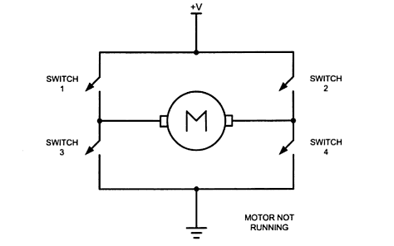
Electronics: H-Bridge for Direction control
Direction Control is realized through ‘H-bridge’
Switches 1, 2, 3, 4 are high-speed, high-current switches
A CPU drives them to give directional speed control
Control can be achieved by
Half-bridge configuration
Full-bridge configuration

Slide 31
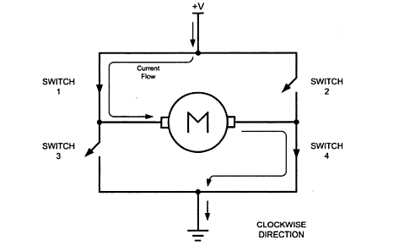
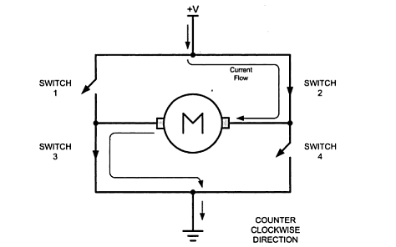
Electronics: H-Bridge operation
Clockwise rotation
Anticlockwise rotation
Switches 1, 4 closed
Switches 2, 3 open
Switches 1, 4 open
Switches 2, 3 closed

Slide 32
ECCP

Slide 33
PIC18F: ECCP – what is it?
ECCP stands for Enhanced CCP
Compare and Capture modes remain as is
PWM gets enhanced (2/4 signal PWM)
PIC18F4520 CCP1 module can work in ECCP mode
CCP1 ECCP use-cases
Bi-directional speed control of DC Motors
Gives 3-pronged control:
On/Off, Speed, Direction
Supports both configurations
Half-bridge
Full-bridge

Slide 34
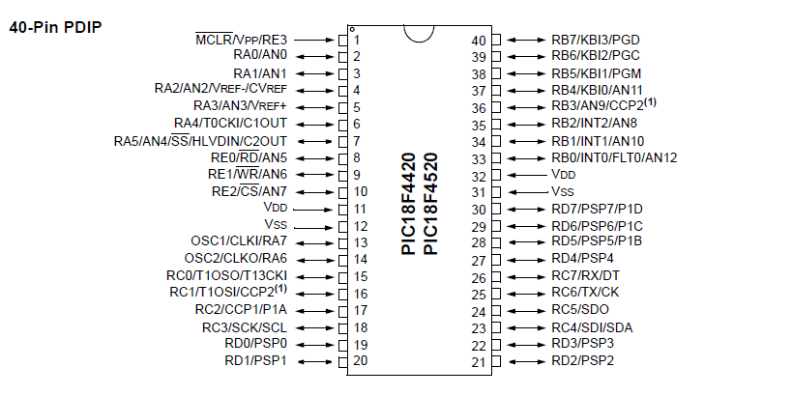
PIC18F: ECCP PWM Pin-out
Up to 4-pin PWM: P1A, P1B, P1C, P1D

Slide 35
PIC18F: CCP1 – ECCP
ECCP-mode CCP1CON
P1M<1:0>: Enhanced PWM output configuration bits
Only when CCP1M3:0 are 11xx
00 Single-output PWM on P1A (P1B, P1C, P1D as port pins)
01 Full-bridge output forward
P1D PWM, P1A active
P1B, P1C inactive
10 Half-bridge output
P1A and P1B PWM
P1C, P1D as port pins
11 Full bridge output reverse
P1B PWM, P1C active
P1A, P1C inactive
P1M1
P1M0
DC1B1
DC1B2
CCP1M3
CCP1M2
CCP1M1
CCP1M0

Slide 36
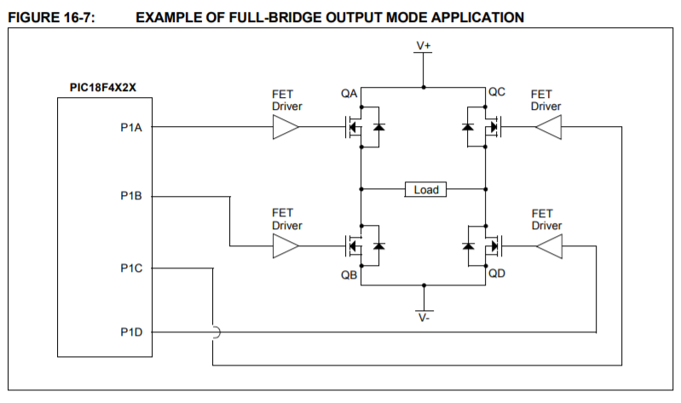
PIC18F: ECCP1 – FB PWM (fwd)
Forward: P1D PWM, P1A active, P1B, P1C inactive
PWM

Slide 37
PIC18F: ECCP1 – FB PWM (rev)
Reverse: P1B PWM, P1C active, P1A, P1D inactive
PWM

Slide 38
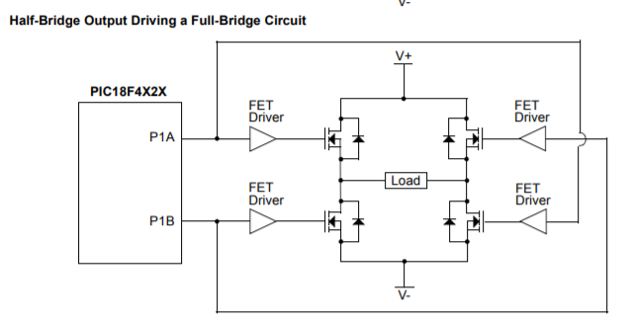
PIC18F: ECCP1 – HB PWM
Half-bridge: P1A and P1B both PWM

Slide 39
PIC18F: CCP Summary
CCP
Concept
CCP details in PIC18F4520
Compare
Capture
PWM
PWM use-cases
Bidirectional speed control using H-bridge
CCP1 in ECCP mode
Half and Full bridge configurations

Slide 40
Thank you!

